Slide 1
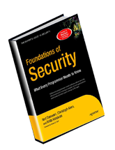
CHAPTER 7
Client-State Manipulation
Slides adapted from "Foundations of Security: What Every Programmer Needs To Know" by Neil Daswani, Christoph Kern, and Anita Kesavan (ISBN 1590597842; http://www.foundationsofsecurity.com). Except as otherwise noted, the content of this presentation is licensed under the Creative Commons 3.0 License.
Notes:
Welcome to SEC103 on Secure Programming Techniques. In this course, I assume that you have some background in computer security, but now you want to put that background to use. For example, in the Computer Security Principles and Introduction To Cryptography courses, we cover topics such concerning trust and encryption. In this course, we put these principles into to practice, and I’ll show you have to write secure code that builds security into your applications from the ground up.

Slide 2
Agenda
Web application – collection of programs used by server to reply to client (browser) requests
  Often accept user input: don’t trust, validate!
HTTP is stateless, servers don’t keep state
  To conduct transactions, web apps have state
  State info may be sent to client who echoes it back in future requests
Example Exploit: “Hidden” parameters in HTML are not really hidden, can be manipulated
Notes:
Also, validating input at client (i.e., with JavaScript) is ineffective for security

Slide 3
7.1. Pizza Delivery Web Site Example
Web app for delivering pizza
  Online order form: order.html – say user buys one pizza @ $5.50
  Confirmation form: generated by confirm_order script, asks user to verify purchase, price is sent as hidden form field
  Fulfillment: submit_order script handles user’s order received as GET request from confirmation form (pay & price variables embedded as parameters in URL)

Slide 4
7.1. Pizza Web Site Code
Confirmation Form:
Submit
Order
Script:
<HTML><head><title>Pay for Pizza</title></head>
<body><form action="submit_order" method="GET">
<p> The total cost is 5.50. Are you sure you
would like to order? </p>
<input type="hidden" name="price" value="5.50">
<input type="submit" name="pay" value="yes">
<input type="submit" name="pay" value="no">
</form></body></HTML>
if (pay = yes) {
success = authorize_credit_card_charge(price);
if (success) {
settle_transaction(price);
dispatch_delivery_person();
} else { // Could not authorize card
tell_user_card_declined();
}
} else { display_transaction_cancelled_page(); // no}

Slide 5
7.1. Buying Pizza Example
Web
Browser
(Client)
Order 1 Pizza
Web
Server
Credit
Card
Payment
Gateway
Confirm $5.50
Submit
Order
$5.50
Price Stored in
Hidden Form Variable
submit_order?price=5.50
Attacker will modify

Slide 6
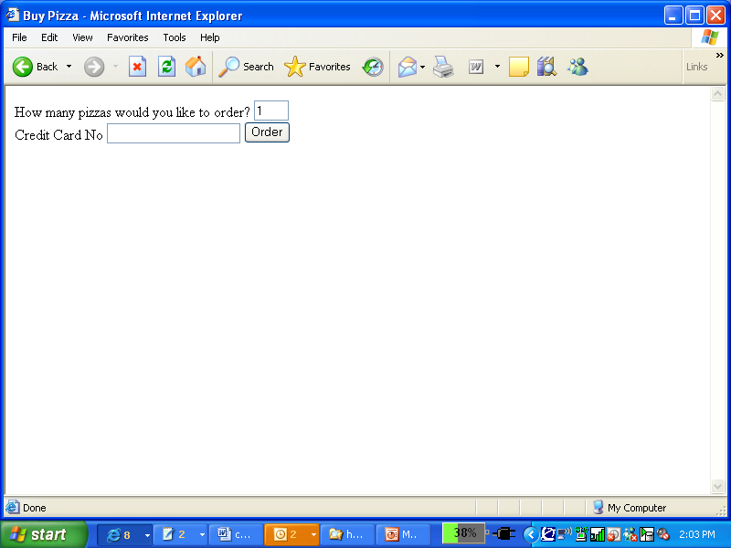
7.1.1. Attack Scenario (1)
Attacker navigates to order form…

Slide 7
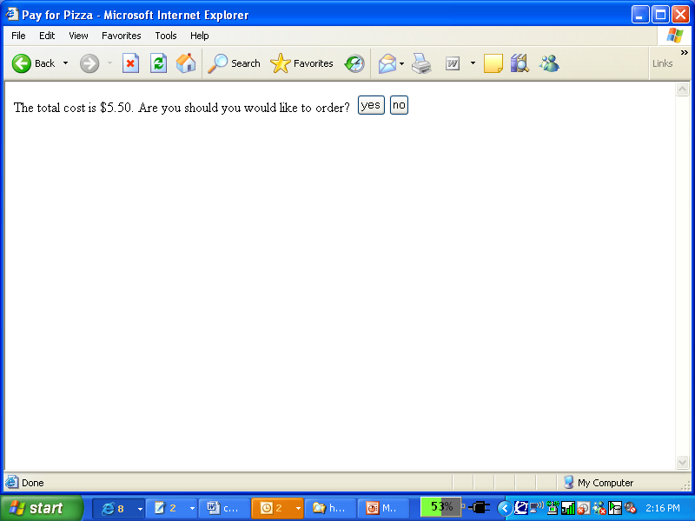
7.1.1. Attack Scenario (2)
…then to submit order form

Slide 8
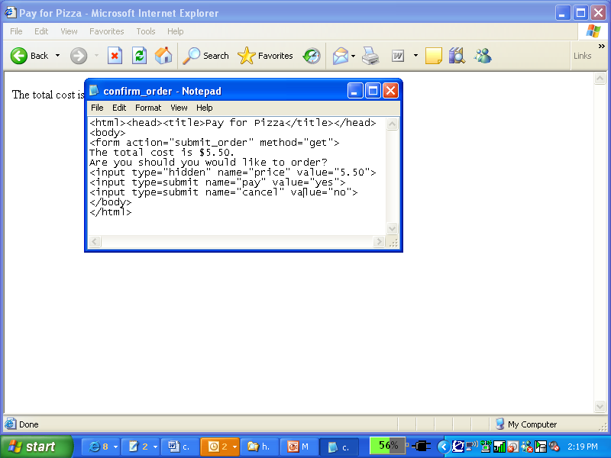
7.1.1. Attack Scenario (3)
And he can View | Source:

Slide 9
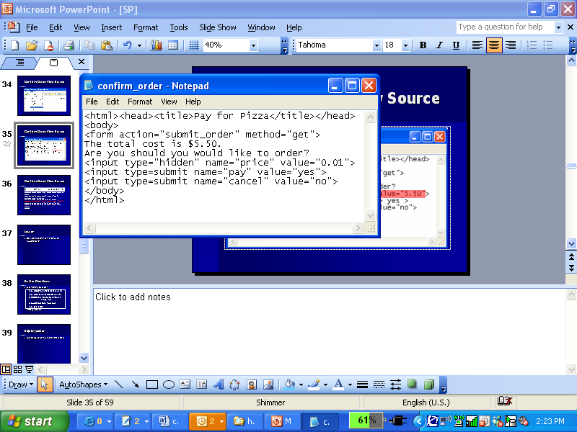
7.1.1. Attack Scenario (4)
Changes price in source, reloads page!
Browser sends request:
GET /submit_order?price=0.01&pay=yes HTTP/1.1
Hidden form variables are essentially in clear

Slide 10
7.1.1. Attack Scenario (5)
Web
Browser
(Client)
Order 1 Pizza
Web
Server
Credit
Card
Payment
Gateway
Confirm $5.50
Submit
Order
$0.01
Attacker modified
Price!

Slide 11
7.1.1. Attack Scenario (6)
Command-line tools to generate HTTP requests
curl or Wget automates & speeds up attack:
curl https://www.deliver-me-pizza.com/submit_order ?price=0.01&pay=yes
Even against POST, can specify params as arguments to curl or wget command
curl -dprice=0.01 -dpay=yes https://www.deliver-me-pizza.com/submit_order
wget --post-data 'price=0.01&pay=yes' https://www.deliver-me-pizza.com/submit_order

Slide 12
7.1.2. Solution 1: Authoritative State Stays on Server
Server sends session-id to client
  Server has table mapping session-ids to prices
  Randomly generated (hard to guess) 128-bit id sent in hidden form field instead of the price.
  New Request
<input type="hidden" name="session-id"
value="3927a837e947df203784d309c8372b8e">
GET /submit_order?session-id=3927a837e947df203784d309c8372b8e
&pay=yes HTTP/1.1

Slide 13
7.1.2. Solution 1 Changes
submit_order script changes:
if (pay = yes) {
price = lookup(session-id); // in table
if (price != NULL) {
// same as before
}
else { // Cannot find session
display_transaction_cancelled_page();
log_client_IP_and_info(); }
} else {
// same no case
}

Slide 14
7.1.2. Session Management
128-bit session-id, n = # of session-ids
  Limit chance of correct guess to n/2¹²⁸.
  Time-out idle session-ids
  Clear expired session-ids
  Session-id: hash random # & IP address – harder to attack (also need to spoof IP)
Con: server requires DB lookup for each request
  Performance bottleneck – possible DoS from attackers sending random session-ids
  Distribute DB, load balance requests

Slide 15
7.1.3. Solution 2:
Signed State To Client
Keep Server stateless, attach a signature to state and send to client
  Can detect tampering through MACs
  Sign whole transaction (based on all parameters)
  Security based on secret key known only to server
<input type="hidden" name="item-id" value="1384634">
<input type="hidden" name="qty" value="1">
<input type="hidden" name="address" value="123 Main St, Stanford, CA">
<input type="hidden" name="credit_card_no" value="5555 1234 4321 9876">
<input type="hidden" name="exp_date" value="1/2012">
<input type="hidden" name="price" value="5.50">
<input type="hidden" name="signature"
value="a2a30984f302c843284e9372438b33d2">

Slide 16
7.1.3. Solution 2 Analysis
Changes in submit_order script:
  Can detect tampered state vars from invalid signature
Performance Hit
  Compute MACs when processing HTTP requests
  Stream state info to client -> extra bandwidth
if (pay = yes) {
// Aggregate transaction state parameters
// Note: | is concatenation operator, # a delimiter.
state = item-id | # | qty | # | address | # |
credit_card_no | # | exp_date | # | price;
//Compute message authentication code with server key K.
signature_check = MAC(K, state);
if (signature == signature_check) { // proceed normally }
else { // Invalid signature: cancel & log }
} else { // no pay – cancel}

Slide 17
7.2. POST Instead of GET
GET: form params (e.g. session-id) leak in URL
  Could anchor these links in lieu of hidden form fields
  Alice sends Meg URL in e-mail, Meg follows it & continues transaction w/o Alice’s consent
Referers can leak through outlinks:
  This <a href="http://www.grocery-store-site.com/"> link
  Sends request:
  Session-id leaked to grocery-store-site’s logs!
GET / HTTP/1.1 Referer:
https://www.deliver-me-pizza.com/submit_order?
session-id=3927a837e947df203784d309c8372b8e

Slide 18
7.2. Benefits of POST
POST /submit_order HTTP/1.1
Content-Type: application/x-www-form-urlencoded
Content-Length: 45
session-id%3D3927a837e947df203784d309c8372b8e
POST
Request:
  Session-id not visible in URL
  Pasting into e-mail wouldn’t leak it
  Slightly inconvenient for user, but more secure
Referers can still leak w/o user interaction
  Instead of link, image:
  <a href=http://www.grocery-store-site.com/banner.gif>
  GET request for banner.gif still leaks session-id

Slide 19
7.3. Cookies
Cookie - piece of state maintained by client
  Server gives cookie to client
  Client returns cookie to server in HTTP requests
  Ex: session-id in cookie in lieu of hidden form field
  Secure dictates using SSL
  Browser Replies:
HTTP/1.1 200 OK
Set-Cookie: session-id=3927a837e947df203784d309c8372b8e; secure
GET /submit_order?pay=yes HTTP/1.1
Cookie: session-id=3927a837e947df203784d309c8372b8e

Slide 20
7.3. Problems with Cookies
Cookies are associated with browser
  Sent back w/ each request, no hidden field to tack on
If user doesn’t log out, attacker can use same browser to impersonate user
Session-ids should have limited lifetime

Slide 21
7.4. JavaScript (1)
Popular client-side scripting language
Ex: Compute prices of an order:
<html><head><title>Order Pizza</title></head><body>
<form action="submit_order" method="GET" name="f">
How many pizzas would you like to order?
<input type="text" name="qty" value="1" onKeyUp="computePrice();">
<input type="hidden" name="price" value="5.50"><br>
<input type="submit" name="Order" value="Pay">
<input type="submit" name="Cancel" value="Cancel">
<script>
function computePrice() {
f.price.value = 5.50 * f.qty.value; // compute new value
f.Order.value = "Pay " + f.price.value // update price
}
</script>
</body></html>

Slide 22
7.4. JavaScript (2)
Evil user can just delete JavaScript code, substitute desired parameters & submit!
  Could also just submit request & bypass JavaScript
Warning: data validation or computations done by JavaScript cannot be trusted by server
  Attacker may alter script in HTML code to modify computations
  Must be redone on server to verify
GET /submit_order?qty=1000&price=0&Order=Pay

Slide 23
Summary
Web applications need to maintain state
  HTTP stateless
  Hidden form fields, cookies
  Session-management, server with state…
Don’t trust user input!
  keep state on server (space-expensive)
  Or sign transaction params (bandwidth-expensive)
  Use cookies, be wary of cross-site attacks (c.f. ch.10)
  No JavaScript for computations & validations

